Slide 1
SWE-4805: Software Verification and Validation
Unit Testing
Md. Nazmul Haque
Lecturer, IUT
Department of Computer Science and Engineering
Islamic University of Technology
December 30, 2021

Slide 2
Contents
Contents
Example of Unit testing

Slide 3
Verification
Calculator example
Assume, there are two types of calculators, Basic and Advanced.
The basic calculator has the following functionalities-
Add(a, b): It takes two numbers as input and returns a+b.
Subtract(a, b): It takes two numbers as input and returns a-b.
Multiply(a, b): It takes two numbers as input and returns a*b.
Divide(a, b): It takes two numbers and returns a/b.
The advanced calculator has the following functionalities-
Pow(x, n): It takes two numbers as input and returns x^n.
Modulo(a, b): It takes two numbers as input and returns a%b.

Slide 4
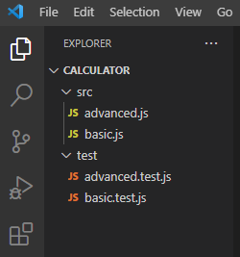
Verification
File Structure

Slide 5
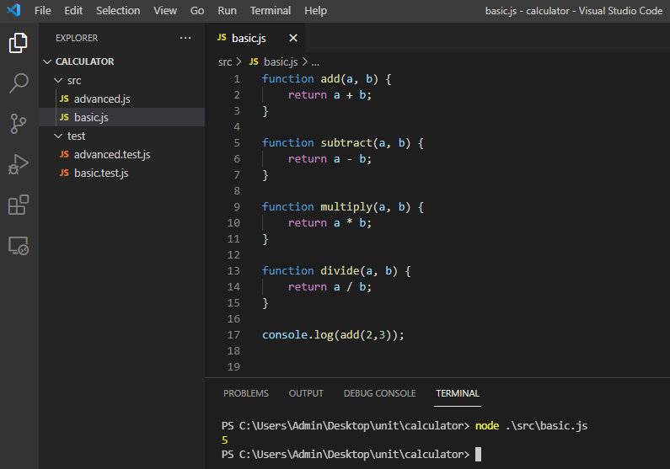
Verification
Basic Calculator: Implementation

Slide 6
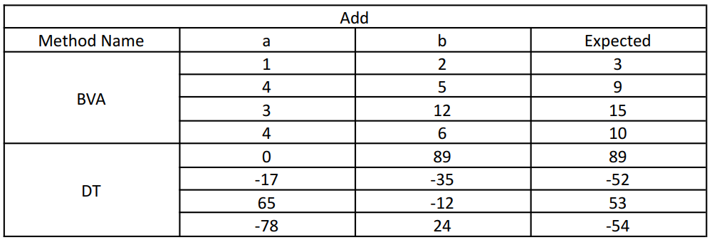
Verification
Test Cases

Slide 7
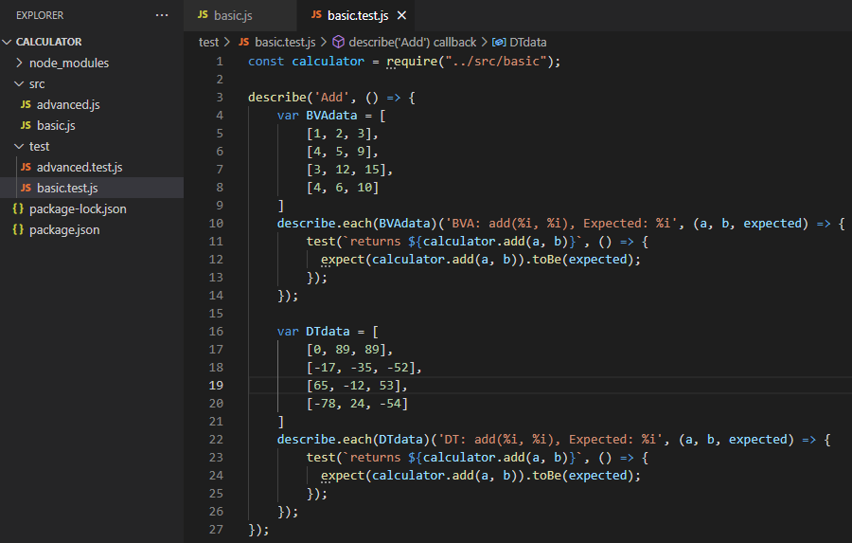
Verification
Basic Calculator: Test

Slide 8
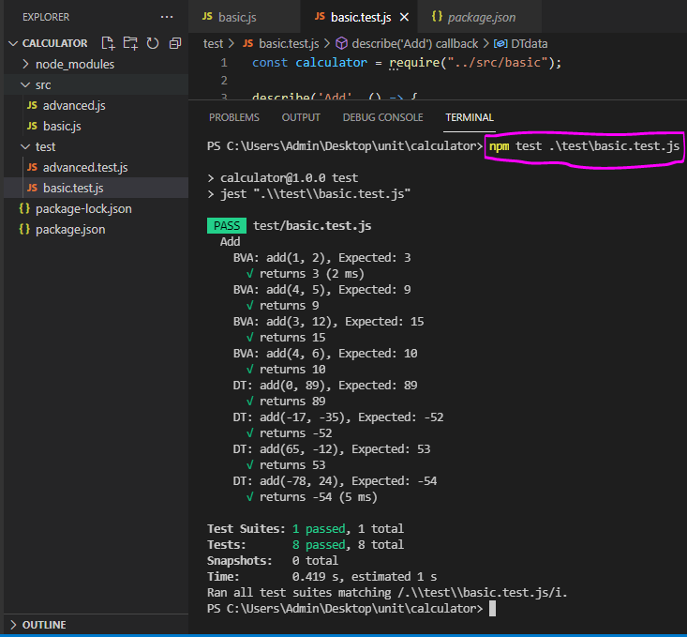
Verification
Basic Calculator: Test result

Slide 9
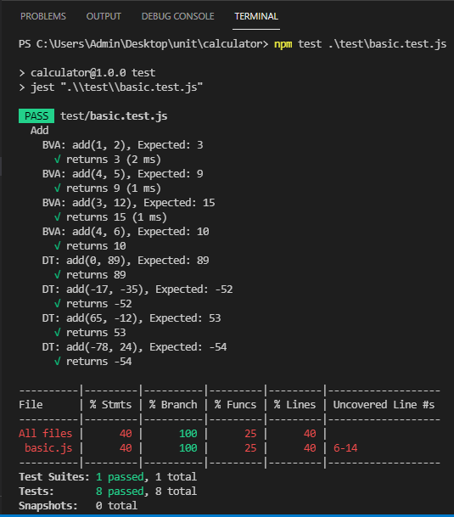
Verification
Basic Calculator: Test

Slide 10
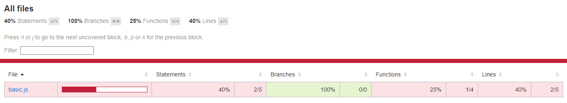
Verification
Basic Calculator: Test

Slide 11
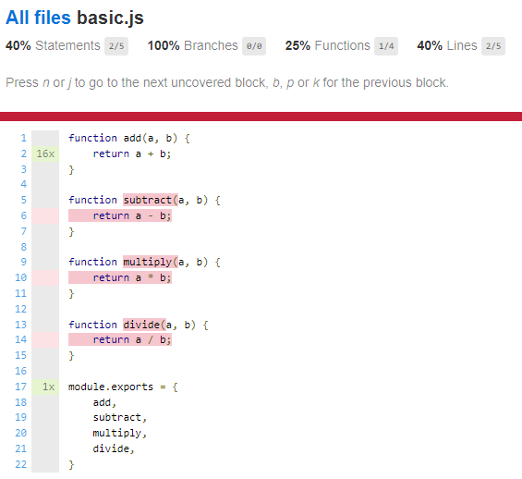
Verification
Basic Calculator: Test

Slide 12
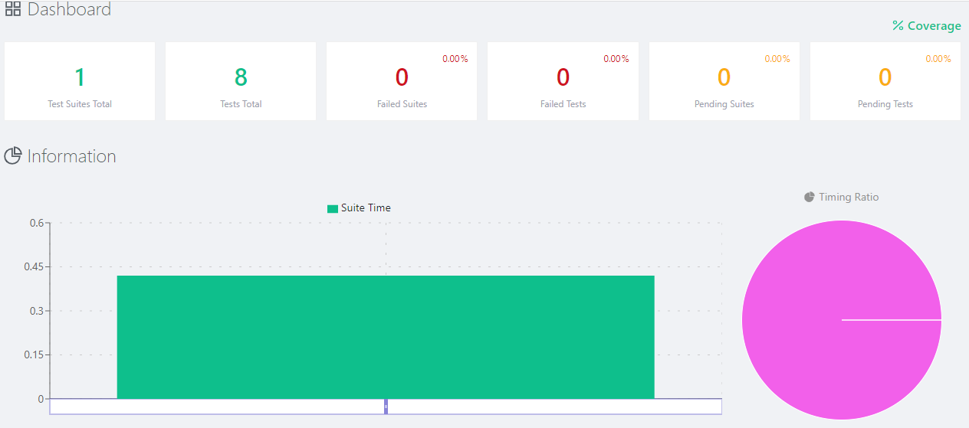
Verification
Basic Calculator: Test

Slide 13
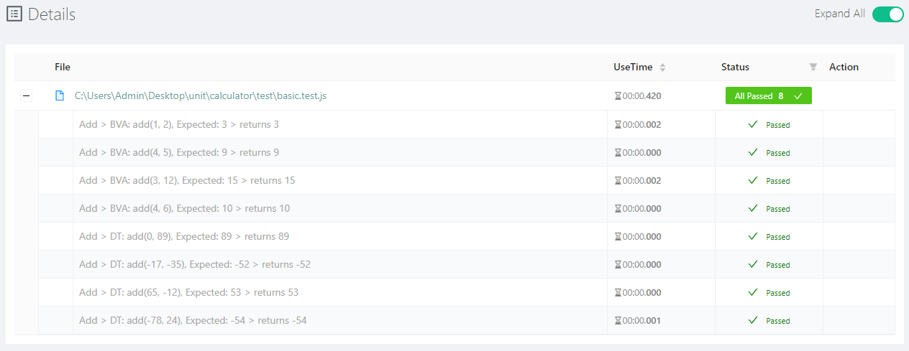
Verification
Basic Calculator: Test

Slide 14
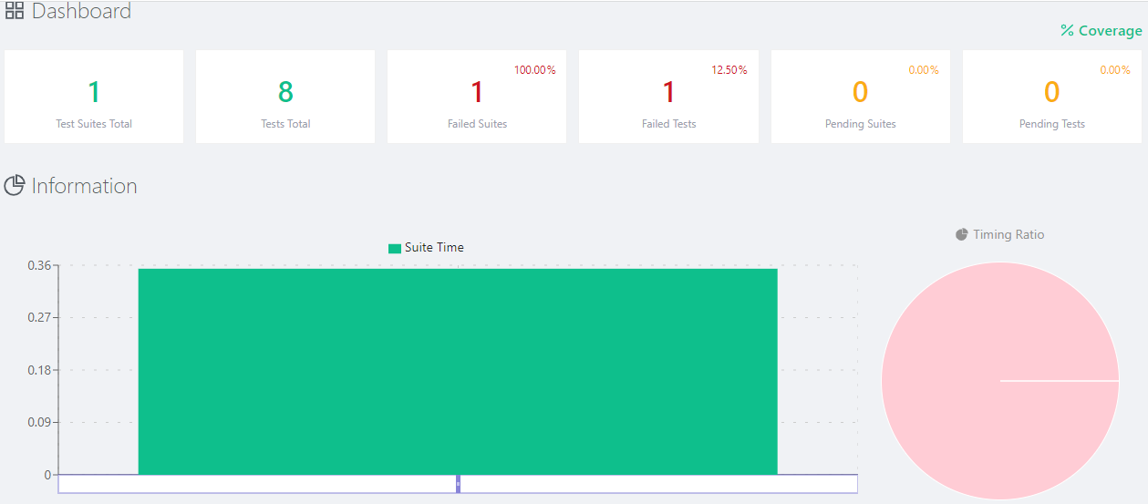
Verification
Basic Calculator: Test

Slide 15
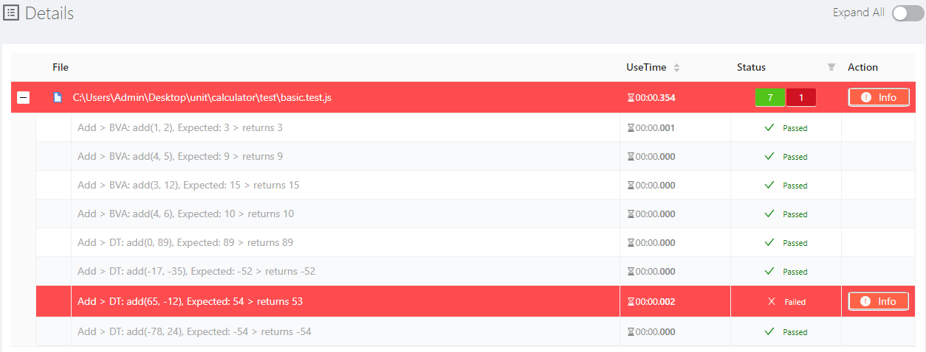
Verification
Basic Calculator: Test

Slide 16
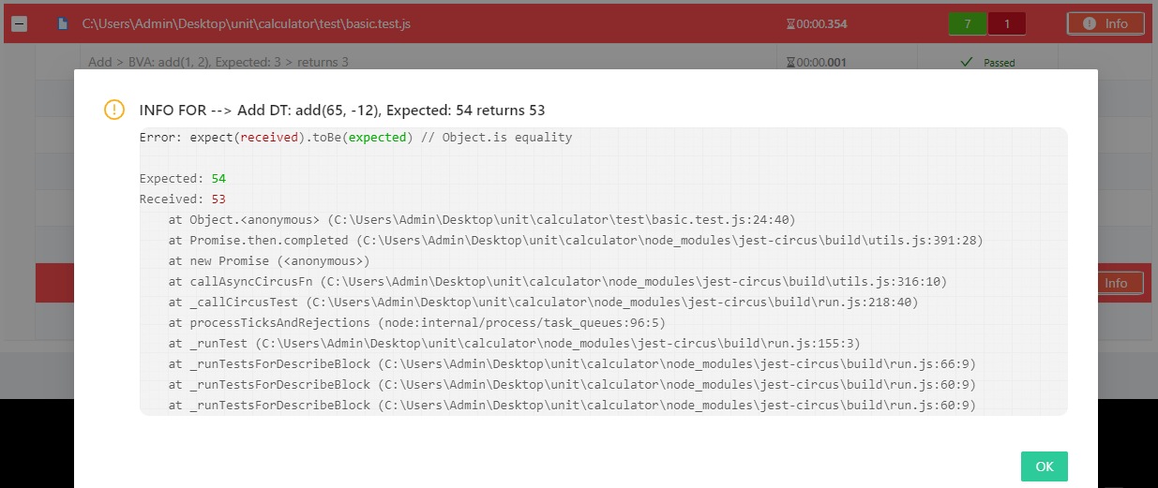
Verification
Basic Calculator: Test

Slide 17
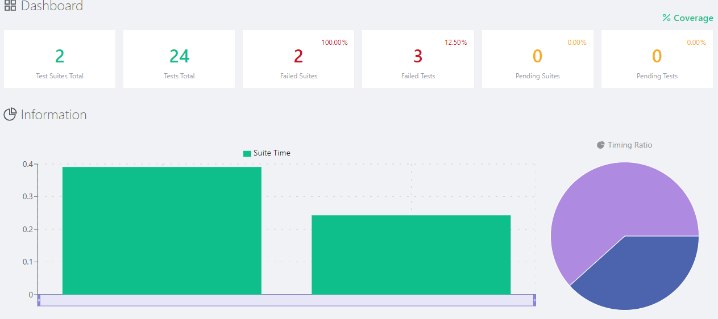
Verification
Basic Calculator: Test

Slide 18
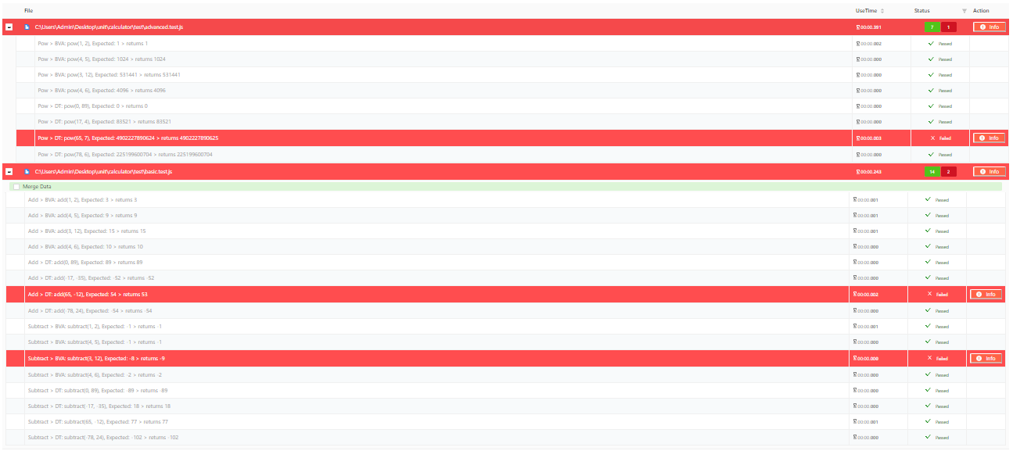
Verification
Basic Calculator: Test

Slide 19
ANY QUESTION ?
THANK YOU !

Slide 20
Acknowledgements
Acknowledgements
[1] Chauhan, Naresh. Software Testing: Principles and Practices. Oxford university press, 2010.

